Slide 1



Python in Greek mythology
Group 1

Slide 2



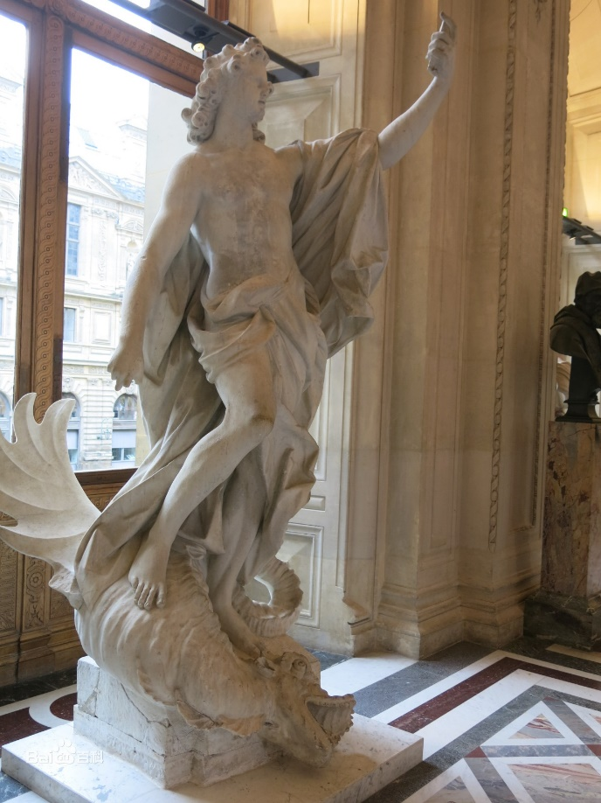



Python : meaning and mythology
English words, meaning giant snake, boa constrictor.
——Originally from Greek mythology
Apollo fought with a female giant snake in Delphi
1

Slide 3



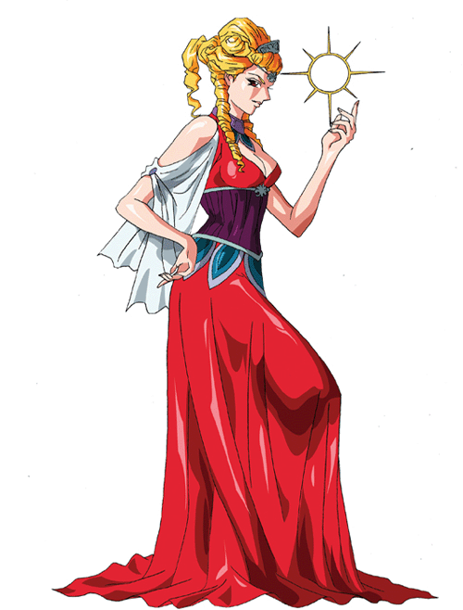




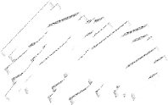
Story of Apollo and Python
A Revenge story…
Apollo's mother leto was chased by python ordered by Hera
Python destroyed everything around it, ready to swallow Apollo
Apollo's golden arrows rained down at python. python died
2

Slide 4

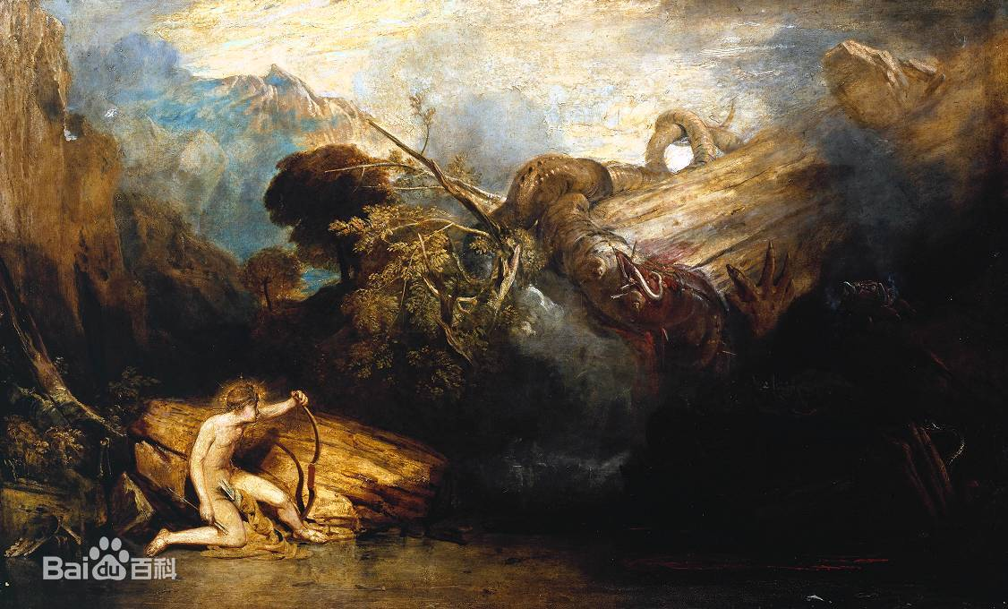

There is another explanation——oracle
Apollo is told to build a temple in Delphi, and first he needs to defeat python nearby
3
Apollo and python (based on Apollo hymn)

Slide 5


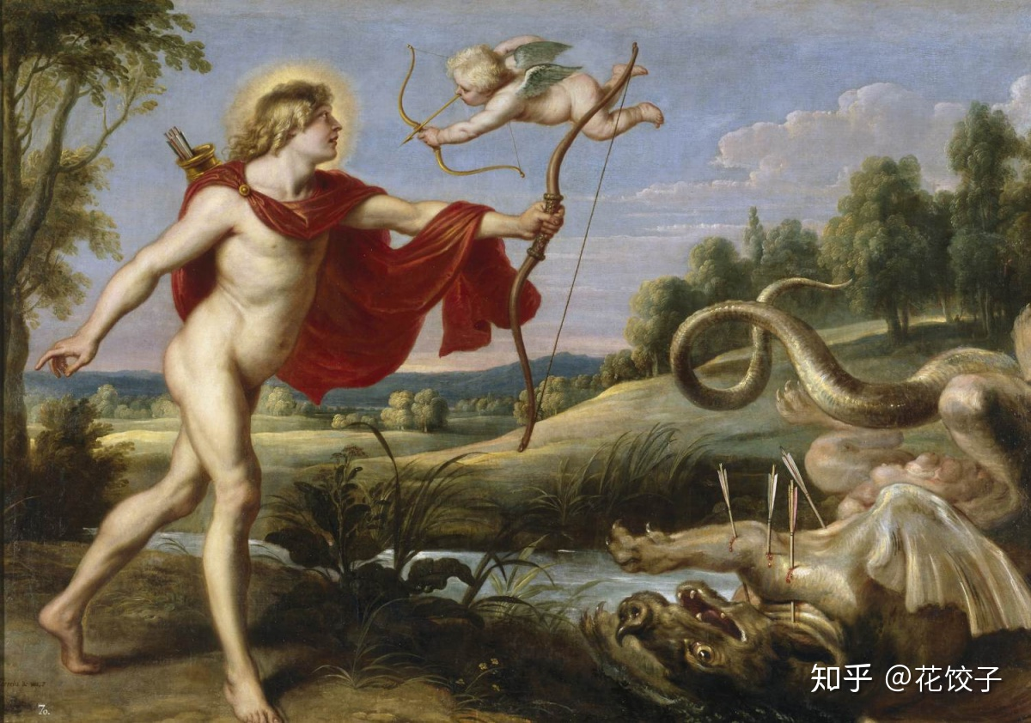






Some interesting rumors afterwards
Lead Arrow
After Apollo shot the giant python, he looked up and saw Eros, his unkind words to Eros kicked off his later love tragedy with Daphne
4

Slide 6




Python named a programming language
Guido van Rossum: his own preference
The name Python comes from Guido's beloved TV series Monty Python's flying circle
5

Slide 7
Thanks for your listening!
Notes:
亮亮图文旗舰店https://liangliangtuwen.tmall.com

